Slide 1
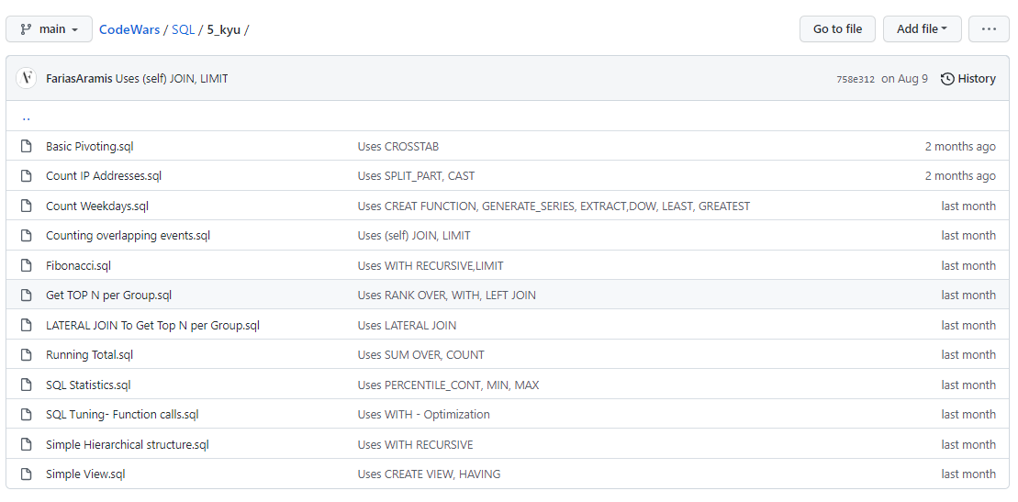
The files are ordered by difficulty
For each challenge the main functions used are pointed for easier reference.

